Slide 1


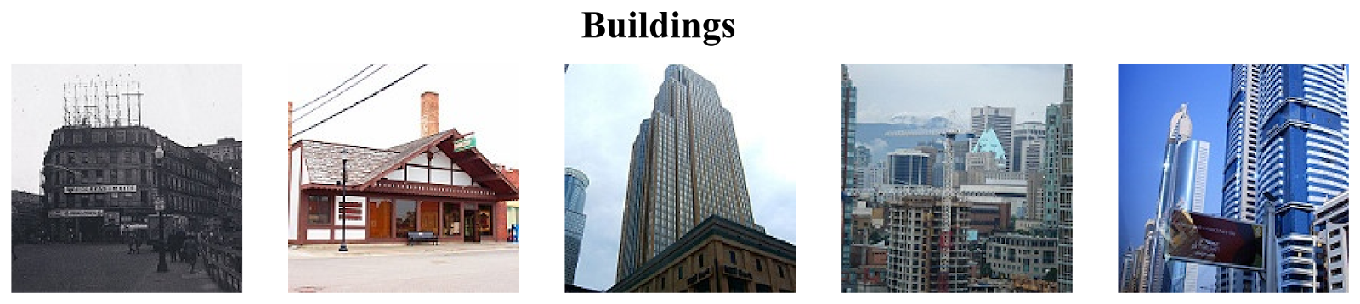
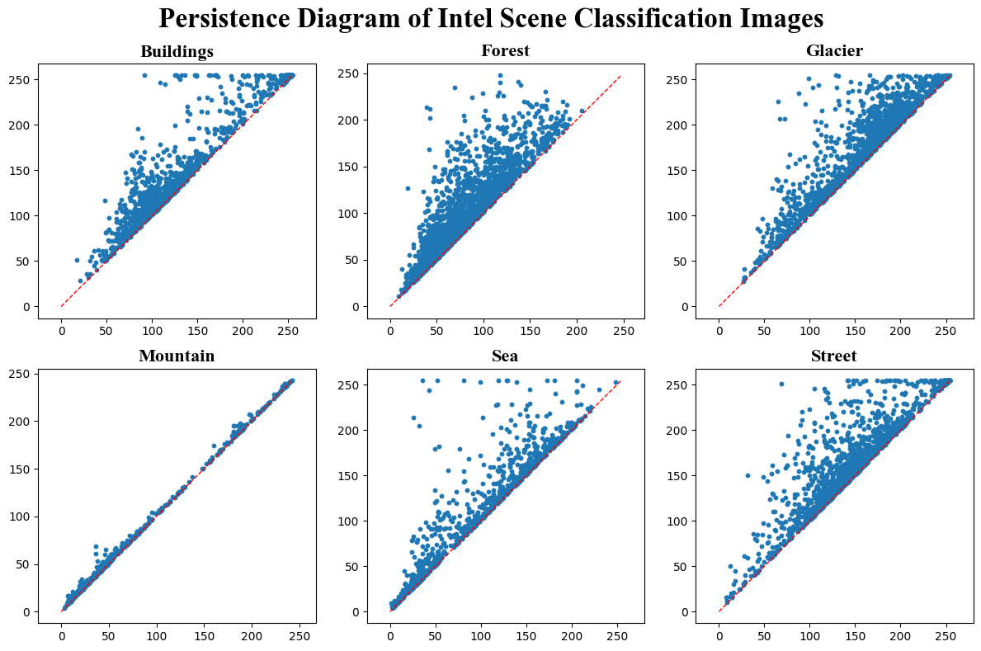
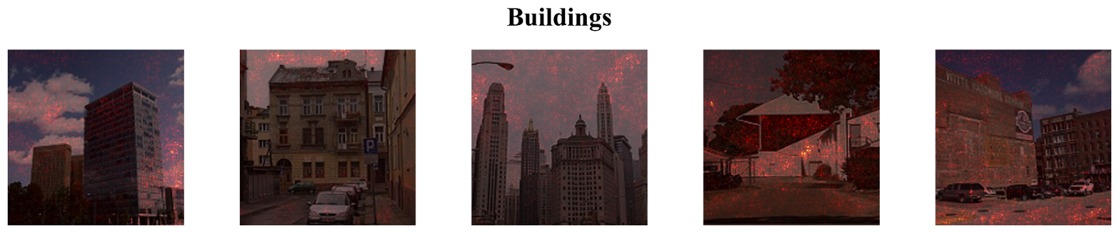
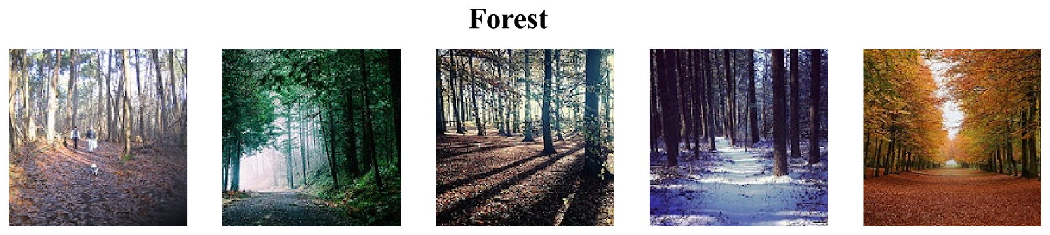
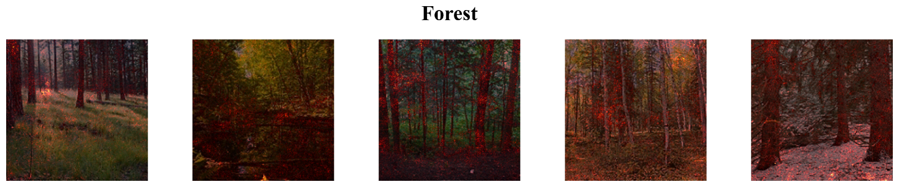
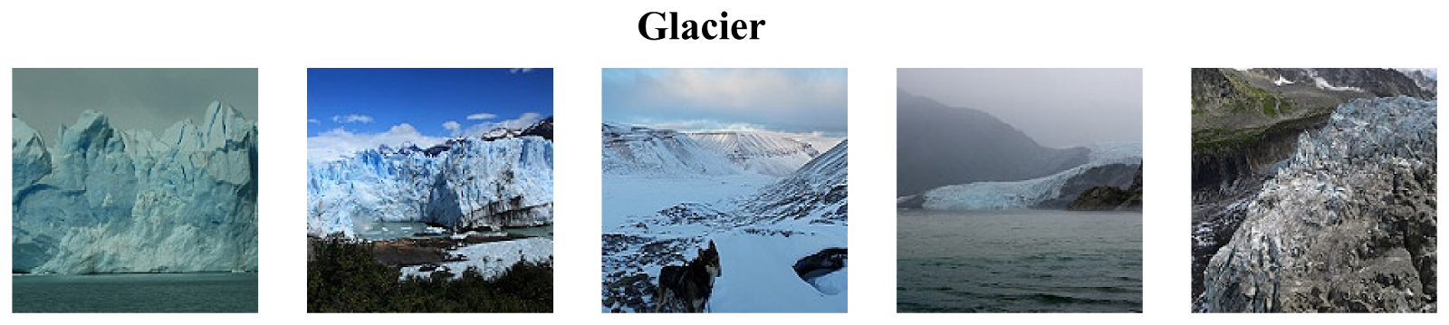
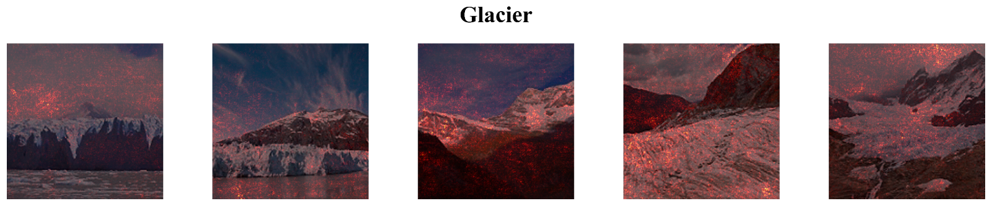
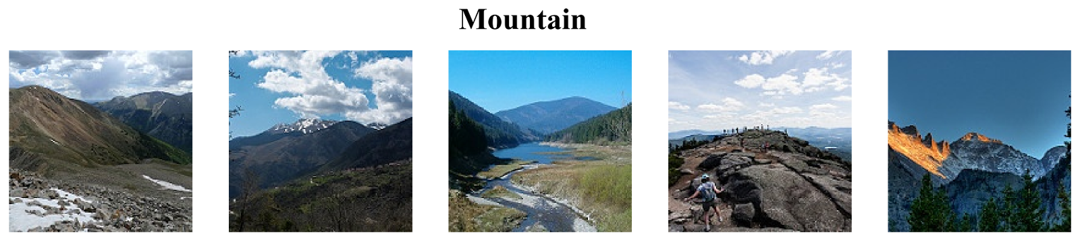
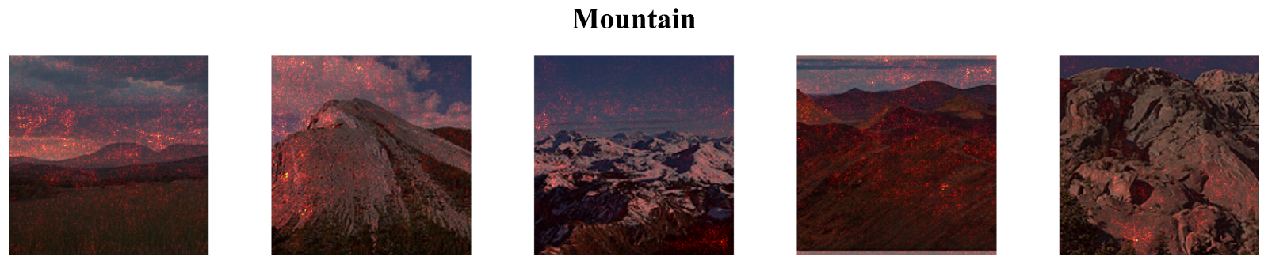
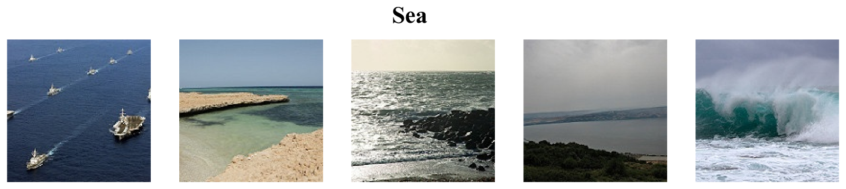
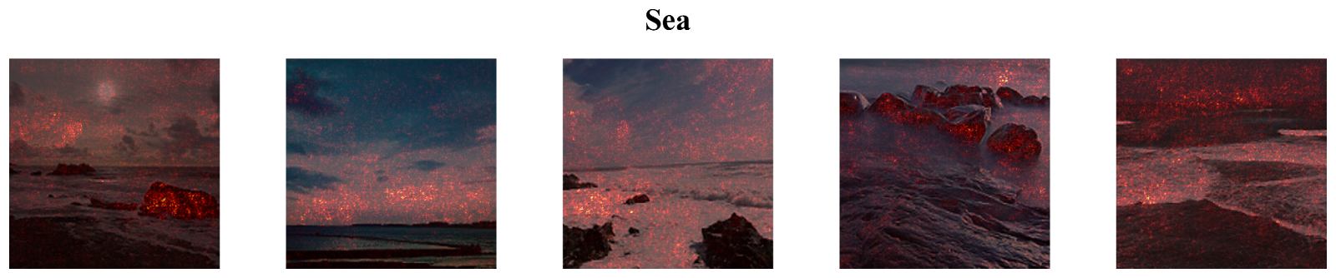
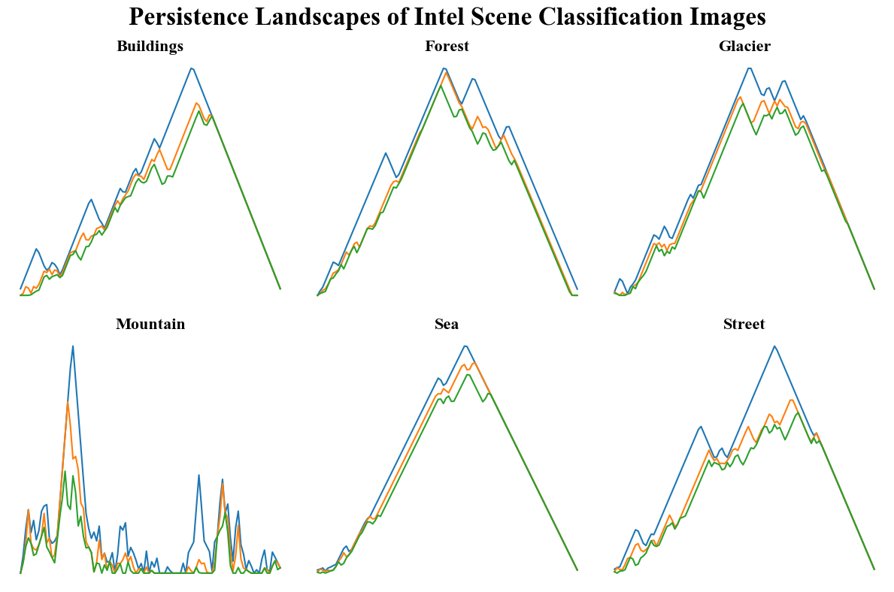
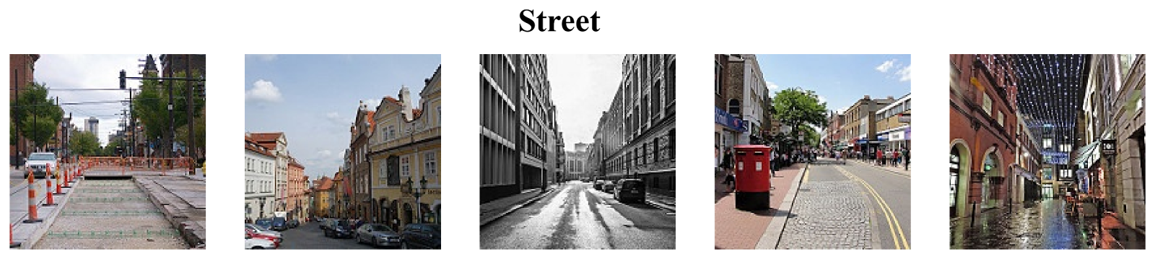
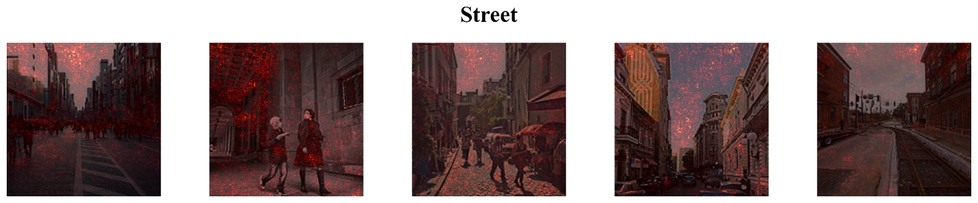
SHAP-Explainable Image-to-Topology Regression
Charles Fanning
Supervisor: Dr. Bin Luo
INTRODUCTION
METHODS
RESULTS & DISCUSSION
Figure 2. Persistence diagrams for one representative image from each class in the Intel Scene Classification dataset. Each point represents the birth and death times of a topological feature, plotted on the horizontal and vertical axes, respectively.
Figure 1. Representative samples from the Intel Scene Classification dataset. Each row displays five randomly selected images from one of the six scene categories: Buildings, Forest, Glacier, Mountain, Sea, and Street.
Figure 4. SHAP explanations for representative samples from the Intel Scene Classification dataset. Each row displays five randomly selected images from one of the six scene categories—Buildings, Forest, Glacier, Mountain, Sea, and Street—with SHAP heatmaps overlaid to highlight the most influential pixel regions contributing to the predicted persistence landscape.
Figure 3. Persistence landscapes for representative images from each class in the Intel Scene Classification dataset. Each plot shows the first three landscape functions
PYTHON CODE

